Slide 1
MuscleHub A/B Test
By Sergio Garcia Puga
November 2019

Slide 2
Does the fitness test intimidate our members?

Slide 3
MuscleHub Gym

Slide 4
Membership
Fitness test
Application form
Monthly Payment
Steps considering buying a membership.

Slide 5


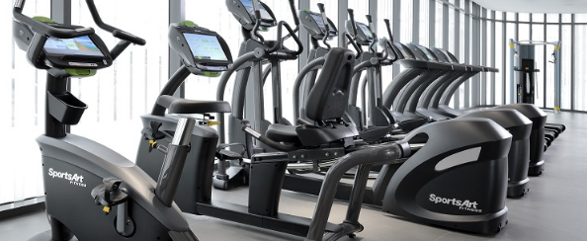
A/B Test: 2 groups
Fitness test with a personal trainer
Skip fitness test and proceed with the application
Which group will be more likely to eventually purchase a membership to MuscleHub?

Slide 6
Our Data

Slide 7
MuscleHub Database
SQLite database with 4 tables:
visits contains information about potential gym customers who have visited MuscleHub
fitness_tests contains information about potential customers in "Group A", who were given a fitness test
applications contains information about any potential customers (both "Group A" and "Group B") who filled out an application. Not everyone in visits will have filled out an application.
purchases contains information about customers who purchased a membership to MuscleHub
Our final dataset contains 5004 rows.

Slide 8
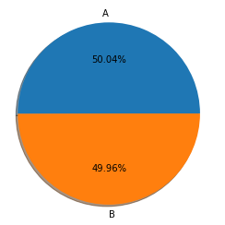
A and B Groups
We are dividing the data in 2 groups:
Group A: visitors that have taken the fitness test
Group B: visitors that have not taken the fitness test

Slide 9
A/B Test - Chi Square

Slide 10
Chi Square Test
For our study we are going to use a Chi Square Test, as we are comparing categorical variables.
The second reason it is because half of the visitors are taking the fitness test and the other half are not. Therefore, makes sense to do an A/B test.

Slide 11
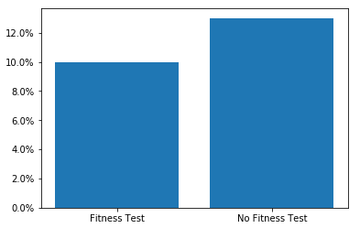

Filling out an application
We are going to if there is significant difference between people that fill or not fill out an application.
The data show us that almost 10% of people that filled the application belong took the fitness test and 13% did not take it.

Slide 12
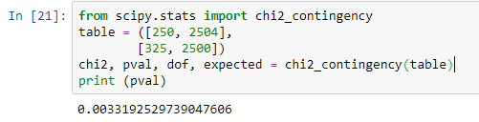
Filling out an application (continued)
After performing our Chi Square test we can say that there is a significant difference between groups as the p-value is smaller than 0.05. Our p-value in this case is 0.003.

Slide 13
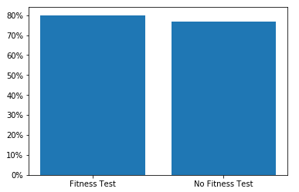

2. Application and purchased a membership?
For those people that filled out the application. Is there any significant difference between those who purchased a membership?
The data show us that almost 80% of people that purchased the membership after filling out the application took the fitness test and 77% did not take it.

Slide 14
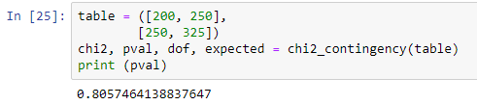
2. Application and purchased a membership? (continued)
In this case, we can say that there is not a significant difference between those who purchased the membership and belong to group A or group B. Our p-value is 0.80.

Slide 15
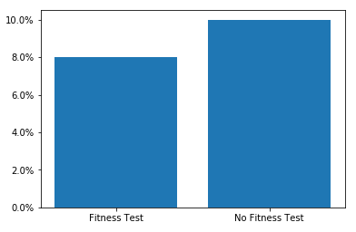

3. All visitors who purchased a membership?
For all visitors, is there any significant difference between those who purchased a membership?
The data show us that almost 8% of all visitors that purchased the membership took the fitness test and 10% did not take it.

Slide 16
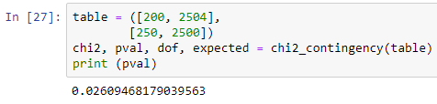
3. All visitors who purchased a membership? (continued)
In this case, we can say that there is a significant difference between those who purchased the membership and belong to group A or group B. Our p-value is 0. 026.

Slide 17
Conclusion

Slide 18
Recommendation
Global data seem to be showing that there are more membership application from people that are not taking the fitness test.
However, even when we receive more application from visitors that does not want to do the fitness test, this does not mean that they will apply to the membership.
I would recommend MuscleHub to perform a survey in order to segment the visitors as could be a different pattern on those intimidated in taking the fitness test.

